Slide 1
Cochrane High School
Graduation Information Meeting 2025

Slide 2
Welcome Class of 2025

Slide 3
Who does what?
Mr. Hooper – Academic Things like credits, graduation requirements, Diploma Exams, etc.
Mme. Petcoff - Graduation Things like convocation, the Google Classroom, grad fees, photos, etc.
Ms. Lebel – Grade 12 Things including academics, post-secondary, trades, scholarships & bursaries, personal issues/counselling, candy and snacks, just a chat
Ms. Lambie – Everything Ms. Lebel does (particularly post-secondary advising) - feel free to contact her if Ms. Lebel isn't available
*Appointments can be booked on the CHS website (under the Learning tab) or by using the QR codes on the guidance office doors.

Slide 5
Convocation 2025
Thursday, June 26th, 2025 9:00am
Spray Lakes Sawmills Family Sports Centre

Slide 6
Lifetouch Grad Photos
December 2 - 12th at CHS
Students book online. The link will be shared with you via the Google Classroom.
30-minute comprehensive sessions dedicated to each Graduate. 15 minutes for cap & gown, 15 minutes for hobby/sport/prom attire, etc.
All graduates must book a time as we need a photo for the composite (no charge for composite sitting).

Slide 7
Grad Fees
Grad fees are still being determined but will cover:
Facility rental
Grad gown, stole, and cap
Diploma cover
Stationery and Supplies

Slide 8
Baby Photos
All graduates are encouraged to send in a baby photo for the Graduation Slide Show.
Photos can be sent to chsgrad@rvschools.ab.ca

Slide 9
GET YOUR DUCKS IN A ROW!

Slide 10
ALBERTA HIGH SCHOOL DIPLOMA REQUIREMENTS
You must earn a minimum of 100 credits from the required courses below:
REQUIRED COURSES
30-level English
30-level Social Studies
20-level Mathematics
20-level Science
Physical Education 10 and Career and Life Management (CALM)
AND EARN 10 CREDITS, IN ANY COMBINATION, FROM: (almost anything EXCEPT Social Sciences, Work Experience, and Green Certificate)
Career and Technology Studies (CTS) - (foods, construction, sports performance, etc.)
Fine Arts (Drama, Music, etc.)
Second Languages (French Language Arts, French as a Second Language)
Physical Education 20 and 30
AND EARN 10 CREDITS IN ANY 30-LEVEL COURSE(S) (not including English and Social Studies), IN ANY COMBINATION, FROM:
30-level math, science, fine arts, second languages, CTS, social sciences, PE, learning strategies
30-level Work Experience; Registered Apprenticeship Program (RAP); and/or Green Certificate

Slide 11
How & when we monitor . . .
October/November - initial credit checks
Midterm check (November) - are you are passing all courses?
January exams & final marks for S1
Midterm check (April) to create final Graduation list in May
You must be on track to meet diploma requirements to participate in graduation
Grad Checklist
PowerSchool
MyPass

Slide 12
How & when YOU monitor . . .
Credit criteria checklist on MyPass - is anything missing? (multiple checks!)
January exams, Diploma marks for S1 and final mark(s)
June final marks & diploma marks (July) for S2
*NOTE: MyBlueprint and Power School DO NOT always accurately represent credits!
Use MyPass!!

Slide 14
Why is MyPass Essential?
● View diploma exam results and request rescores
● Register to write a diploma exam
● Order High School transcripts
● View progress towards a credential (diploma or certificate)
● View and print a Detailed Academic Report (DAR)
● View student personal information

Slide 16
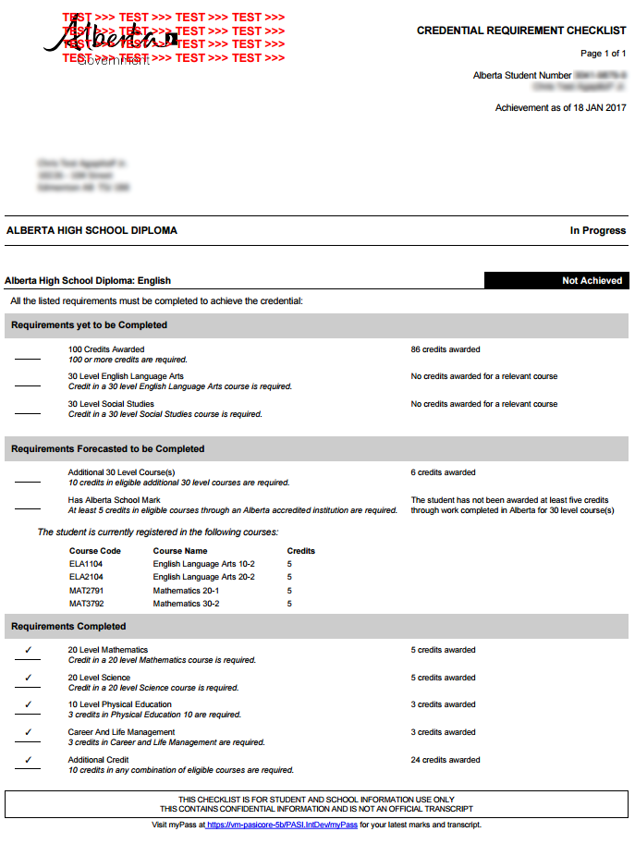
Detailed Academic Report (DAR)
Graduation Checklist

Slide 17
Careers and Post-Secondary Advising
Team "T & T" are here to help
Career Centre! (coming soon)
Post-Secondary Programs and MyBlueprint
Scholarship Directory/Booklet
Post-secondary presentations
Application assistance and lunchtime workshops

Slide 18
UNIVERSITY APPLICATIONS ARE OPEN
APPLY EARLY!

Slide 19
SCHOLARSHIPS Where to Look...​
Cochrane High Scholarship Booklet
Alis Government Website​​
Studentawards.Com​​
Scholartree.Ca​​
Scholarshipscanada.Com​​
Yconic.Com​

Slide 20
School-Nominated Awards
Only one application form is required for all school-nominated awards.
Deadlines vary – Pay close attention!
​Some awards are based on financial need and some are for specific fields of study.
One Example:
SCHULICH AWARD - $120,000 designated for students pursuing an engineering degree, and $100,000 designated for students pursuing a science, technology or math degree.

Slide 21
Local Scholarships Require an Application Package
See the Scholarship Book for Details ​
Deadline around April 1st
SMALLER POOL = GREATER OPPORTUNITY

Slide 22
There is NO one place where all scholarships are housed. You will need to commit time, creative Googling, and investigative skills to find the best scholarships for you.

Slide 23
Indigenous Students
University of Alberta – Free Application Days September 30 – October 9
Mount Royal University – Free Application October 1-7; special consideration for seats in competitive entrance programs
University of Calgary – Free application when attending Start Your Journey Webinar for Indigenous Students, Advising Days, or Open House
NAIT – Waived tuition deposit; admission pathways to competitive entrance programs
Bow Valley College – 2 free applications per year
Norquest College – No application fees and no tuition deposit
*make sure to check with each school to ensure these incentives are
still in place when applying
Did you know....
Many institutions are working to remove barriers to education for Indigenous students.

Slide 24
Upcoming Open Houses
Olds College – Fri. & Sat., October 4 & 5
St. Mary’s University (Calgary) – Saturday, October 5
SAIT – Fri. & Sat., October 18 & 19, 9am – 3pm
Mount Royal University – Saturday, October 19, 9am – 3pm
Ambrose University – Saturday, October 19, 10am – 2pm
Bow Valley College – Saturday, October 26
University of Calgary – Saturday, October 26

Slide 25
Post-Secondary Fairs
Out-of-Province (OOP) Post-Secondary Fair
October 17TH Bow Valley High School Gym
6:00-7:30 PM
Alberta (ELAA) Post-Secondary Fair
November 26 Cochrane High School Gym
6:30-8:00 PM

Slide 26
Post-Secondary Presentations (at lunch in room 1062)
OCTOBER
Wednesday, Oct. 9th – SAIT
*Wednesday. Oct. 30th – Queen's University
**3:40pm
NOVEMBER
Wednesday, Nov. 13th – UBC
Tuesday, Nov. 19th – Police Cadets
Monday, Nov. 26th - MRU

Slide 27
Upcoming Presentation
Accommodations and Accessibility in Post-Secondary with Dr. Ana Pardo​
Wednesday, October 16th at 6pm​ a CHS
Location: TBD (room dependent on numbers)
Information about how to register is located in your folder.

Slide 30
Banquet Info

Slide 31
PLEASE HELP US PUT AWAY YOUR CHAIR AT THE END OF PRESENTATION

