Slide 1
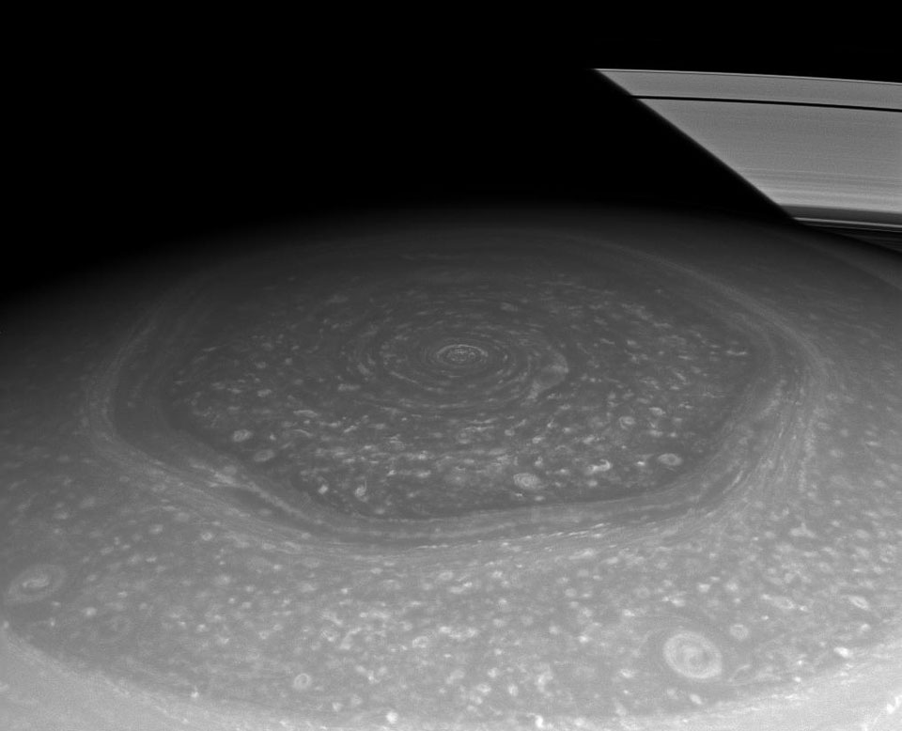
SPACE EXPLORATION UNIT
Topic 5 – What Channel is That?
(pages 393-398)

Slide 2
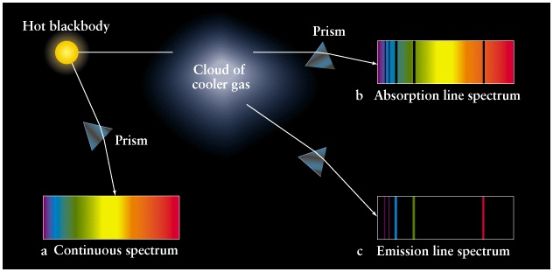
3 Types of Spectra
Continuous spectrum (high gas pressures or heated solid or liquid >> emits light at all wavelengths when heated)
Emission spectrum (excited or heated gas at low pressure)
Absorption spectrum (hot solid, liquid or gas passing through cool gas)

Slide 3
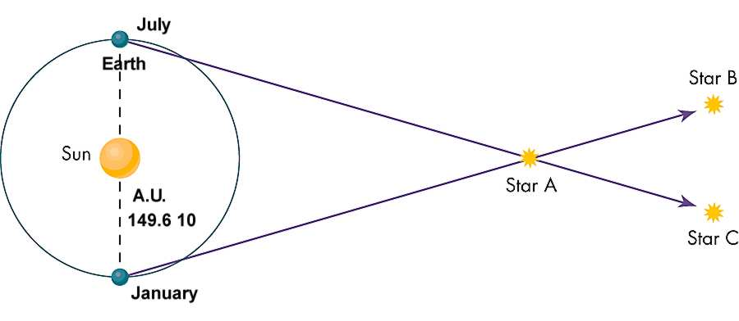
Review
the astronomical unit: 1 AU is the distance from the Earth to the Sun = 150 million km
light year: the distance light travels in one year (63 240 AU or 9.5 trillion km
Light travels at 300 000 km/s (goes around the earth 7.4 times in 1 second)
Notes:
• since the solar system is so large we need a large unit of measurement, the astronomical unit: 1 AU is the distance from the Earth to the Sun = 150 million km
the nearest star to the Earth is Proxima Centari, 272 000 AU
The nearest galaxy to the milky way is Andromeda: 2 million light years away.
The visible universe (from telescopes) has a diameter of 28 Billion light years
• But the universe is so much larger than our solar system, using AU outside our solar system is impractical (it would be like using mm to measure distances across Canada). So astronomers created the light year: the distance light travels in one year (63 240 AU).
• Light travels at 300 000 km/s. 1 light year = 9.5 trillion (9.5 x 10¹²) km. Calculate how many light years Proxima Centauri is from Earth. ___________

Slide 4
% error (example)
Calculated distance = 80 meters
Measured distance = 83 meters
% error = 100 x (measured – calculated) / measured
% error = 100 x (83 – 80) / 83 = 3.6%

Slide 5
Unit Overview - Last Class recap – Any questions?
Unit topic | Status
1 – Azimuth-altitude (+ activity) & models of solar system | 100% Complete
2 – Telescopes, elliptical orbits & universal gravitation | 100% Complete
3 – The Spectroscope & Doppler effect | 100% Complete
4 – Bigger telescopes and triangulation ( + activity) | 80% Complete
5 – Radio telescopes | Today
6 – Rockets, computers, hazards of space, microgravity, space stations, gravitational assist, CCD’s and satellites / GPS
7 – The Solar System
8 – People in Space

Slide 6
M51: The Whirlpool Galaxy in Dust and Stars http://apod.nasa.gov/apod/

Slide 7
Radio telescope –Arecibo, Puerto Rico
Notes:
AM/FM Radio Waves
This week's experiment comes from a question that I received about which is better, AM or FM radio. As we shall see, the answer depends on what you are looking for. To try this, you will need:
- an AM/FM radio. This can be either a portable radio or the radio in your car. Do not use internet radio, as that will not work for this experiment. - a rope about 6-10 feet long
We will begin by listening to some radio stations. Set your radio to the AM setting, and slowly scan through the stations. Listen to each station, to see how clear the reception is, how much static you can hear, and the radio stations call letters. The call letters will be four letters, such as WJRK. Write down the information for each station you can find.
Then do the same thing with the FM stations, again taking notes on reception, static, and call letters. When you are finished, go online, and look up the radio stations that you heard. I did a search for "Jacksonville radio stations" and found most of the stations that I picked up. For each station that you found, write down what city it is located in.
Compare the two lists. Do you see a difference? You probably found that the AM stations tended to have more static, but that you could pick up stations from far away. With FM, the signal was clearer, but all of the stations were fairly local.
The next step in our experiment requires you to move around a bit. Switch your radio back to AM, and tune it to a station that you like. If you are using the radio in your car, drive around a bit. Notice what happens to your radio reception when you drive into a parking garage, under an overpass, or when you cross a bridge that has metal supports. You will probably find that the reception becomes much worse, and the station may disappear until you exit the structure. If you are using a hand held radio, put on your ear phones, and try walking around your local shopping mall or grocery store. You should notice the same thing, with your signal varying a LOT, depending on where you are.
Switch back to the FM setting, and find a station that you like. Then try listening in the same places (parking garage, shopping mall, etc.) Try finding a dead spot for the AM radio, and then switching to an FM station while you are still in the same spot.
You will probably find that dead spots are fairly common with AM stations, while FM stations are usually clear pretty much where ever you go.
OK, so why the difference? To understand that, we need to know what AM and FM stand for. In both, the "M" stands for modulation. Modulation is a series of changes that you use to send a signal. For example, if you were using a flash light to send Morse code signals, you would turn the light on and off in a pattern of dots and dashes. This is known as PM, which stands for pulse modulation. You are sending the signal by using patterns of pulses.
AM stands for amplitude modulation. That word amplitude sounds an awful lot like the word amplifier, and with good reason. Amplifiers make a signal stronger, for example, a musical amplifier can make your radio louder. For AM, the radio signal varies in how strong the waves are.
Since we can't see the radio waves, lets use the rope to understand. Tie one end of the rope to a door knob. Hold the other end of the rope, and move away from the door until the rope is fairly straight, but still a little slack. Start moving your hand up and down to form waves in the rope. Notice that you can move your hand gently to produce small waves, and you can move your hand more forcefully to produce tall waves. You are modulating the amplitude of the waves.
FM stands for frequency modulation. With radio waves, as with other waves, frequency tells us how frequently the waves are passing. We can illustrate that with the rope too. This time, instead of changing the amount of force you use to shake the rope, change how quickly you shake the rope. You will find that you can shake it slowly to make waves that are far apart, or you can shake it quickly to make waves that are close together. You are modulating the frequency of the waves in the rope.
The strength of a signal tends to vary by distance and location. Changes in strength cause changes in amplitude (AM), but not changes in frequency (FM.) This causes AM stations to have more static and interference than FM stations.
Another big difference between AM and FM is the length of the waves. For FM, the waves are fairly short, usually around nine to twelve feet. Short waves are much better at getting into buildings, bridges, and other metal structures, but they are easily blocked by large objects, such as mountains, and they do not travel very far.
For AM, the waves are much longer, often more than a mile long. These long waves are easily blocked by metal structures, making it difficult to get good reception in bridges, stores, and parking garages. On the other hand, the long waves are much better at moving around mountains, and they can travel hundreds of miles, letting you hear stations in distant cities.
So which is better? Well, that depends on what you want. For listening to local stations, FM tends to give a much better signal, with good reception in most locations. On the other hand, if you are on a long trip, FM stations tend to fade quickly as you drive along, while you may be able to listen to the same AM station for hours before you lose the signal. If you are on a camping trip, or somewhere away from cities, AM stations may be the only stations that you can pick up.
So get out your radio, and do some testing. Just remember that this is a test. This is only a test. In the event of a real emergency, you would be directed to the nearest ice cream shop for some emergency rations.

Slide 8
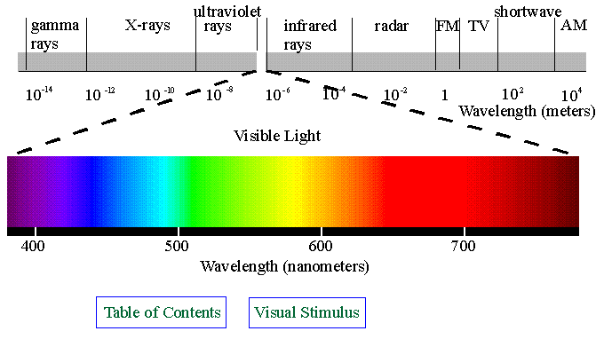
Development of radio telescopes
The next advancement in understanding the universe was the development of radio telescopes.
Notes:
Previous telescopes used visible light to learn about the stars. Look at the electromagnetic spectrum on page 393. Visible light is only one small part of the electromagnetic radiation given off by stars. Stars give off lots of other electromagnetic radiation (radio waves, infrared waves, etc). Analyzing these other rays give scientists more information about the composition and properties of stars.

Slide 9
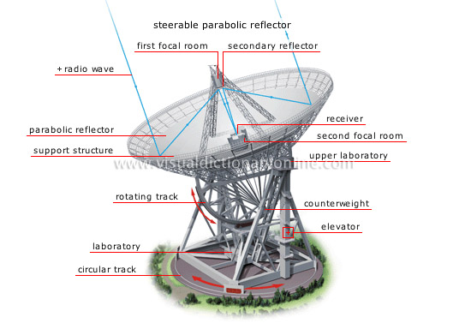
Radio Telescopes
Karl Jansky (1932) was having trouble with radio emissions that were interfering with their telephones and learned that the interfering radio waves were coming from outer space (built radio antennae & noticed interference set with sun ,etc)
Advantages: radio waves can penetrate dust clouds in space, pollution, weather etc whereas visible light cannot, so now astronomers could study celestial objects they had never seen before. Can also use radio telescopes during the day.
Notes:
Karl Jansky (1932) was an engineer for Bell Telephone. They were having trouble with radio emissions that were interfering with their telephone industry. Jansky build a radio telescope and learned that the interfering radio waves were coming from outer space!
Radio astronomy uses radio waves to learn about the stars. Radio objects, like stars, are celestial bodies that give off large amounts of radio waves.
Using radio telescopes scientists could capture the radio waves from radio objects. This was a big advancement: radio waves can penetrate dust clouds in space whereas light cannot, so now astronomers could study celestial objects they had never seen before because they are blocked by space dust.
Radio telescopes have to be much larger than optical telescopes because their resolution is not as good as light telescopes because radio waves have such a large wavelength. Why: think v = fλ (speed = frequency x wavelength)
How do the radio telescopes “see” the stars? Astronomers use computers to convert the strength of the radio signals to color to produce a radio image of the celestial body they are looking at (stars, galaxies…). (See pg. 395).
Just like light telescopes, scientists use interferometry, linking telescopes that are far away by electrical wires or computers so they act like one large telescope. The Very Large Array (VLA) is an example of this, 27 large radio telescopes are electrically connected. (See pg. 396). It is so accurate that the centimeter marks on a ruler could be seen from 5 km away if the ruler were broadcasting radio waves!
Imagine this! Very long baseline interferometry (VLBI). Linking radio telescopes can now be done with just computers so astronomers can combine signals from as many radio telescopes on earth or in space as they want! One VLBI project uses space and ground based telescopes simulating a single dish 2x the diameter of Earth!

Slide 10
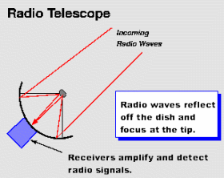
How do radio telescopes work
They focus the extremely weak, incoming radio waves to an antenna that then amplifies the signal.

Slide 11
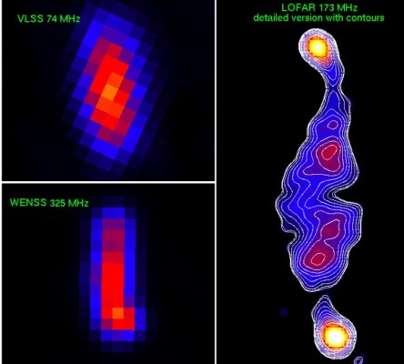
Radio Telescopes
Radio telescopes have to be much larger than optical telescopes? Why?
Long wavelength enables radio waves to go around large objects. AM vs FM radio stations.
How do the radio telescopes “see” the stars? Computers convert the radio signals to color to produce a radio image of the celestial body (See pg. 395).
Notes:
Radio telescopes have to be much larger than optical telescopes because their resolution is not as good as light telescopes because radio waves have such a large frequency.
How do the radio telescopes “see” the stars? Radio telescopes do not “see” anything as the signals are not in the visible spectrum. Astronomers use computers to convert the strength of the radio signals to color to produce a artificial radio image of the celestial body they are looking at (stars, galaxies…). (See pg. 395).
Just like light telescopes, scientists use interferometry, linking telescopes that are far away by electrical wires or computers so they act like one large telescope. The Very Large Array (VLA) is an example of this, 27 large radio telescopes are electrically connected. (See pg. 396). It is so accurate that the centimeter marks on a ruler could be seen from 5 km away if the ruler were broadcasting radio waves!
Imagine this! Very long baseline interferometry (VLBI). Linking radio telescopes can now be done with just computers so astronomers can combine signals from as many radio telescopes on earth or in space as they want! One VLBI project uses space and ground based telescopes simulating a single dish 2x the diameter of Earth!

Slide 12
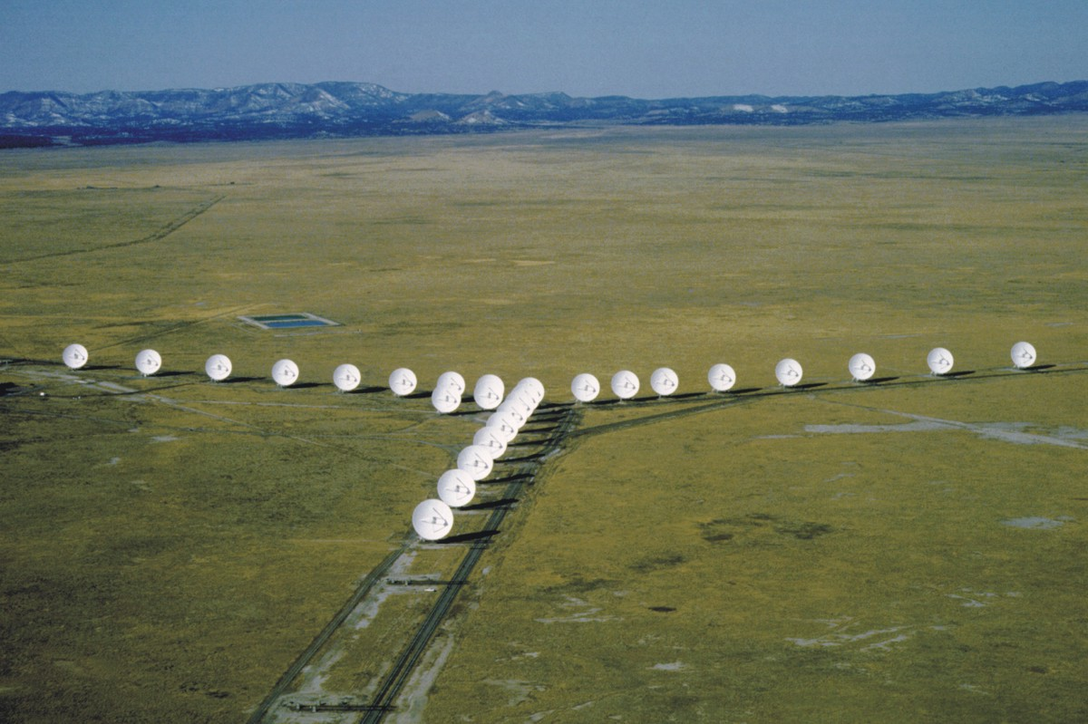
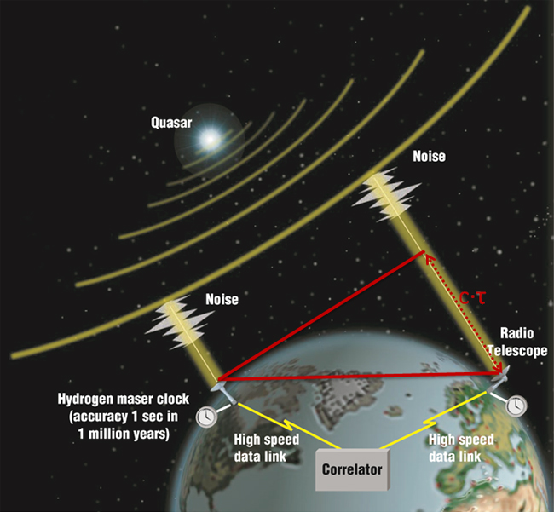
Connecting telescopes
Interferometry: connecting telescopes with wires and combining signals using computer (image as good as if one telescope the size of the distance between the 2 used)
Very Long baseline interferometry (VLBI): connecting telescopes without wires using timed signals & computers.

Slide 13
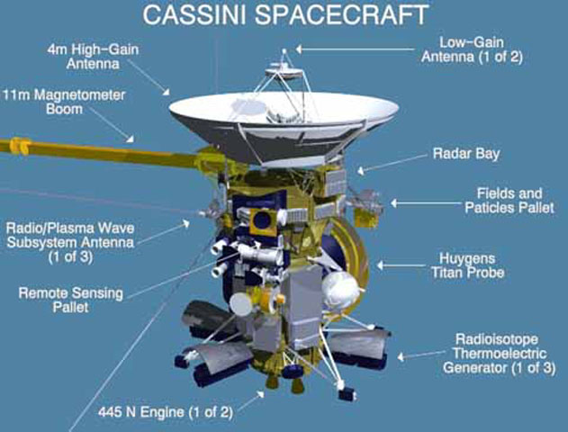
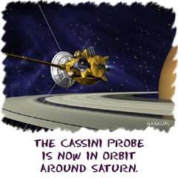
Space Probes
Radio / optical telescopes can’t provide all the answers.
Sometimes we must send observation equipment right to the object.
Unmanned space probes make observations of other planets, asteroids, etc. (some do fly bys, some become satellites of other planets and some land).

Slide 14
Assignment (homework for tomorrow)
❒ Do topic 5 review (pg 397)
❒ Complete “Radio Telescopes and the Electromagnetic Spectrum” BLM 5-11
❒ Do Wrap-Up Topics 3-5 pg. 398 #1 and #8.
Notes:
How do you do triangulation?
• You measure the distance of an object indirectly by making an imaginary triangle between the observer and the object (i.e. star) whose distance you want to measure.
• Make a base line with the object to be measured in between the 2 points A and B. The larger the baseline the more accurate the distance you calculate.
• Make a line from the two points to the object and measure the two angles using some form of protractor
• Make a scale diagram (i.e. 1 cm = 10m) of the imaginary triangle to calculate the distance using a baseline ‘S’ with a number of cm that will fit on the page. The imaginary triangle will have the same angles as the real world triangle.
IMPORTANT: The ratio D/S for the imaginary triangle will be the same ratio D/S for the real world triangle when the triangles share the same angles A & B.

