Slide 1
Is this photo shopped?

Slide 2
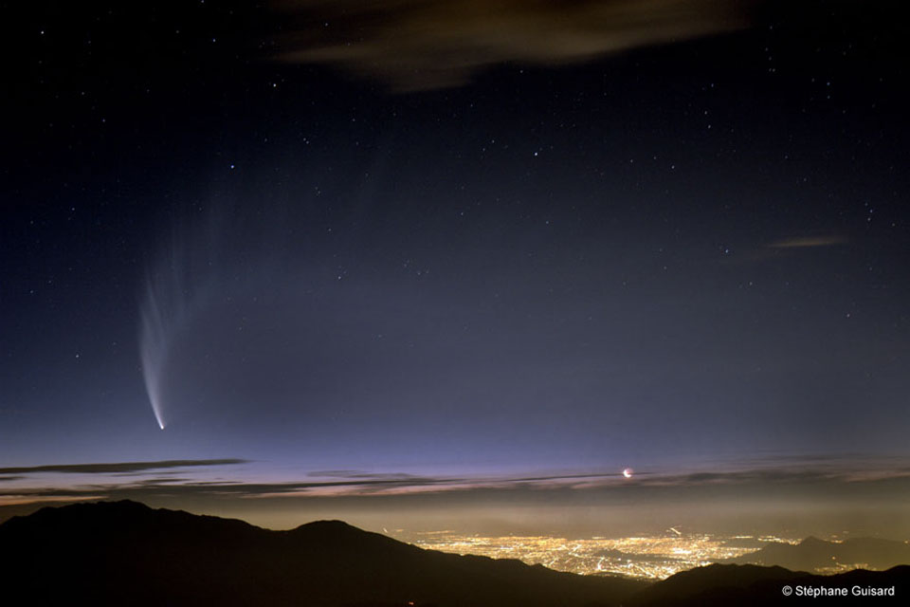
SPACE EXPLORATION UNIT
Topic 4 – Bigger, Smarter Telescopes
(pages 385-392)

Slide 3
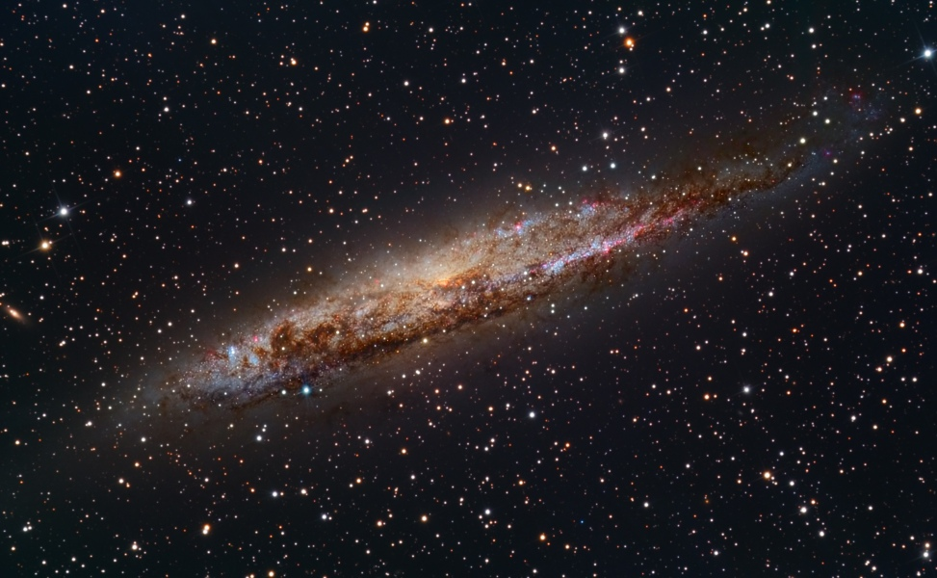
Nearby Spiral Galaxy NGC 4945
http://apod.nasa.gov/apod/ap130123.html

Slide 4
Unit Overview - Last Class recap – Any questions?
Unit topic | Status
1 – Azimuth-altitude (+ activity) & models of solar system | 100% Complete
2 – Telescopes, elliptical orbits & universal gravitation | 100% Complete
3 – The Spectroscope & Doppler effect | 50% Complete
4 – Bigger telescopes and triangulation ( + activity) | Today/tomorrow
5 – Radio telescopes
6 – Rockets, computers, hazards of space, microgravity, space stations, gravitational assist, CCD’s and satellites / GPS
7 – The Solar System
8 – People in Space

Slide 5
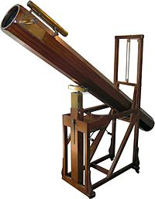
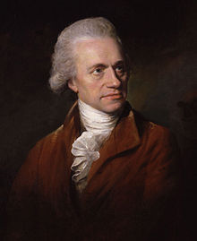
The Next Discoveries
1773, Sir William Herschel built a large reflecting telescope and discovers a new planet: Uranus!
He was an astronomer and musician (he composed 24 symphonies) !!!!
Worked with his sister who made many discoveries on her own.

Slide 6
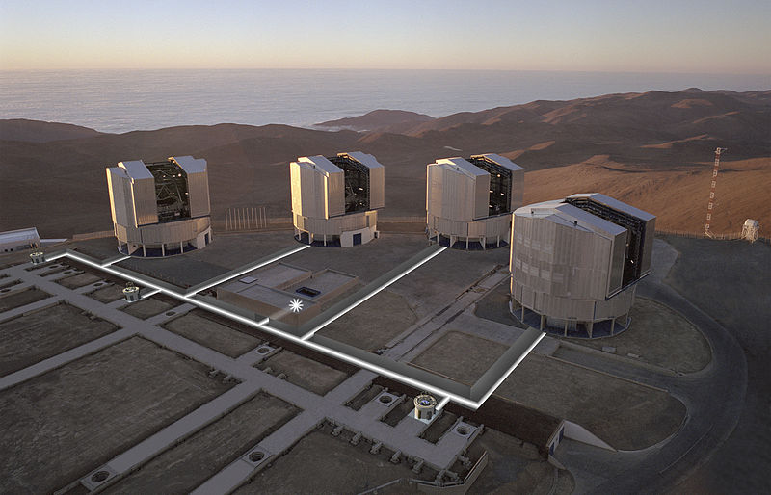
Combining Telescopes
Using computers to combine images from >1 telescope
Acts like telescope the size of the distance between telescopes (greatly improves resolving power)
The Very Large Telescope (VLT) is operated by the European Southern Observatory in Chile
Notes:
Now powerful computers can combine images from 2 or more telescopes (interferometry). The two separate telescopes act like one large telescope the size of the total distance between the two telescopes! This provides great resolving power. The twin Keck telescopes in Hawaii have such a high resolving power they can distinguish each headlight on a car 800 km away! (p. 385)

Slide 7
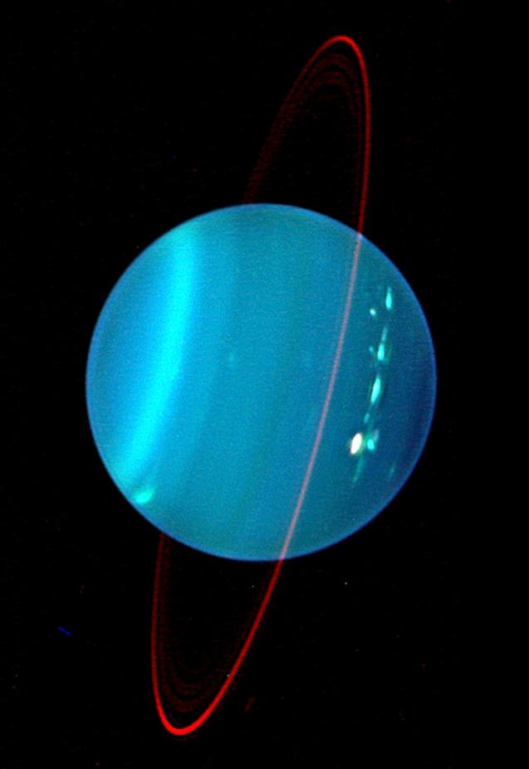
Keck telescope
On Hawaii
2007 photo of Uranus
See ring

Slide 8
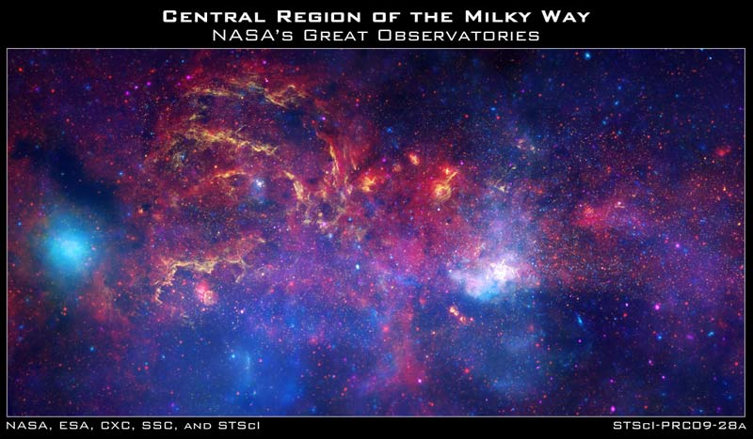
NASA picture of the Milky Way’s Centre
This giant composite image has been taken by NASA's three Great Observatories (Hubble & Spitzer Space Telescopes and the Chandra X-ray Observatory.

Slide 9
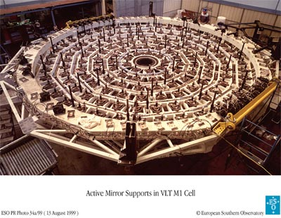
Adaptive Optics
Why do the stars twinkle?
What is light pollution?
How to astronomers deal with air pollution?
Notes:
• Why do stars twinkle? Why is this a problem for astronomers? The Earth’s atmosphere refracts starlight in random directions so astronomers can’t see stars clearly. When light from a star or another astronomical object enters the Earth's atmosphere, atmospheric turbulence (introduced, for example, by different temperature layers and different wind speeds interacting) can distort and move the image in various ways
• How do astronomers correct this problem? They use adaptive optics: computers process the images and remove the blurring effect of the Earth’s atmosphere. The software “adapts” as the Earth’s atmosphere changes.
• What is light pollution? Why is this a problem for astronomers? Light pollution is the glow in the sky at night caused by all the artificial lighting found in and around cities. Astronomers can see only the brightest stars.
• How do astronomers deal with air pollution?
They locate telescopes in remote areas (i.e. up north or on a mountain top).

Slide 10
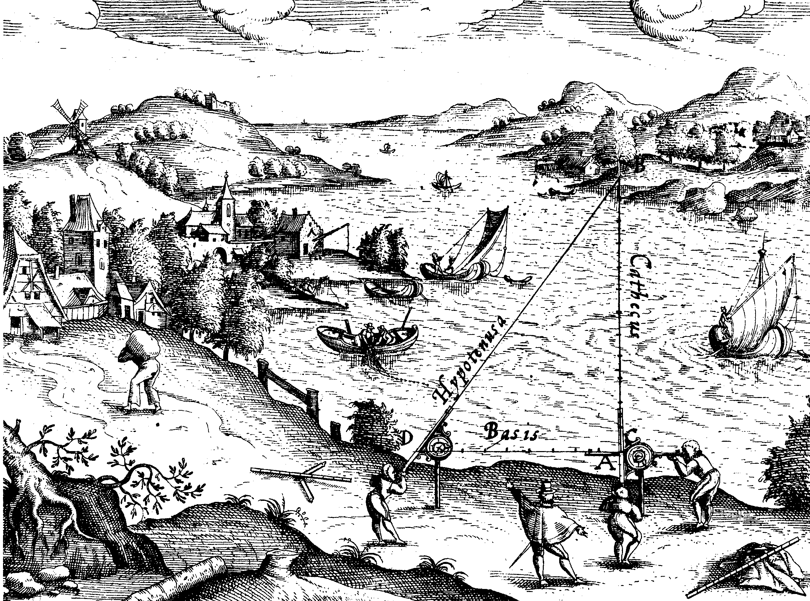
How far away are the stars?
Astronomers use a method called triangulation to measure far away distances.
Parallax is a difference in apparent position of an object viewed along two different lines of sight.

Slide 11
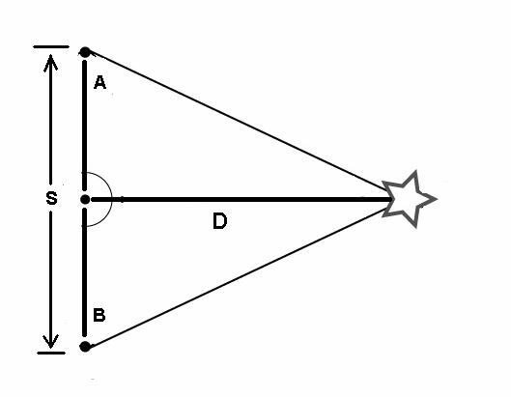
Triangulation
How do you triangulate?
You can find distance D to an object by knowing S and angles A & B (and then creating a scale drawing)
Why would you do this?
Notes:
How do you do triangulation?
• You measure the distance of an object indirectly by making an imaginary triangle between the observer and the object (i.e. star) whose distance you want to measure.
• Make a base line with the object to be measured in between the 2 points A and B. The larger the baseline the more accurate the distance you calculate.
• Make a line from the two points to the object and measure the two angles using some form of protractor
• Make a scale diagram (i.e. 1 cm = 10m) of the imaginary triangle to calculate the distance using a baseline ‘S’ with a number of cm that will fit on the page. The imaginary triangle will have the same angles as the real world triangle.
IMPORTANT: The ratio D/S for the imaginary triangle will be the same ratio D/S for the real world triangle when the triangles share the same angles A & B.

Slide 12
Example:
You are standing beside a lake, looking at a tree on an island. You need to know the distance to the tree but no means of measuring the distance directly.
Is there some other way you can estimate it? --- YES!!
By using a distance you know, you can calculate the unknown distance indirectly. Triangulation measures distance indirectly by creating an imaginary triangle between the observer and tree.
It is the same method that astronomers use to measure distances to celestial objects.
The figure below describes step by step how.
longer the baseline, the more accurate the results providing the angles work.

Slide 13
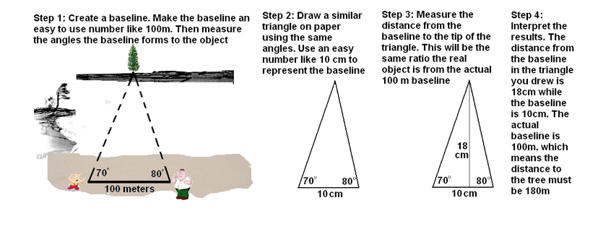
The process
If the real triangle and scale triangle have the same angles, then the ratio of triangle height to base is same for both.

Slide 14
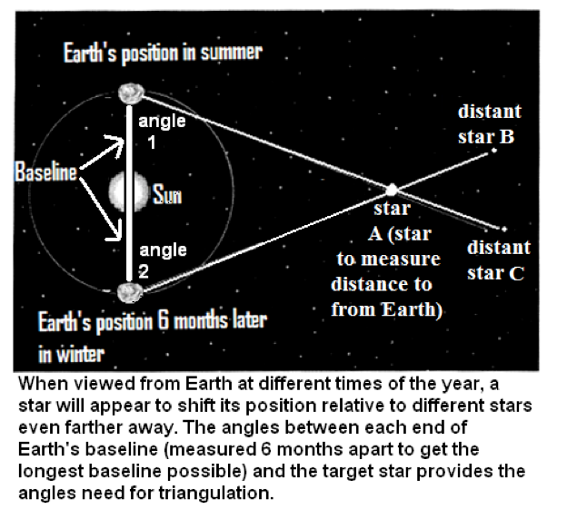
Triangulating a star
The diameter of the Earth’s orbit is the baseline and we view the star from one point on the Earth 6 months apart (i.e. in December and then again in June), lining up the star to distant stars as the frame of reference.

Slide 15
How Big is big?
the astronomical unit: 1 AU is the distance from the Earth to the Sun = 150 million km
But the universe is so much larger than our solar system, So astronomers created the light year: the distance light travels in one year (63 240 AU).
1 light year = 9.5 trillion km
Light travels at 300 000 km/s (goes around the earth 7.4 times in 1 second)
The visible universe (from telescopes) has a diameter of 28 Billion light years
Notes:
• since the solar system is so large we need a large unit of measurement, the astronomical unit: 1 AU is the distance from the Earth to the Sun = 150 million km
the nearest star to the Earth is Proxima Centari, 272 000 AU
The nearest galaxy to the milky way is Andromeda: 2 million light years away.
The visible universe (from telescopes) has a diameter of 28 Billion light years
• But the universe is so much larger than our solar system, using AU outside our solar system is impractical (it would be like using mm to measure distances across Canada). So astronomers created the light year: the distance light travels in one year (63 240 AU).
• Light travels at 300 000 km/s. 1 light year = 9.5 trillion (9.5 x 10¹²) km. Calculate how many light years Proxima Centauri is from Earth. ___________

Slide 16
Practice:
Do the practice sheet “triangulation worksheet BLM 5-9” #1-3.
❒ Assignment: Topic 4 Review # 1-5 p. 392
❒ Complete your vocab for Topic 4

