Slide 1
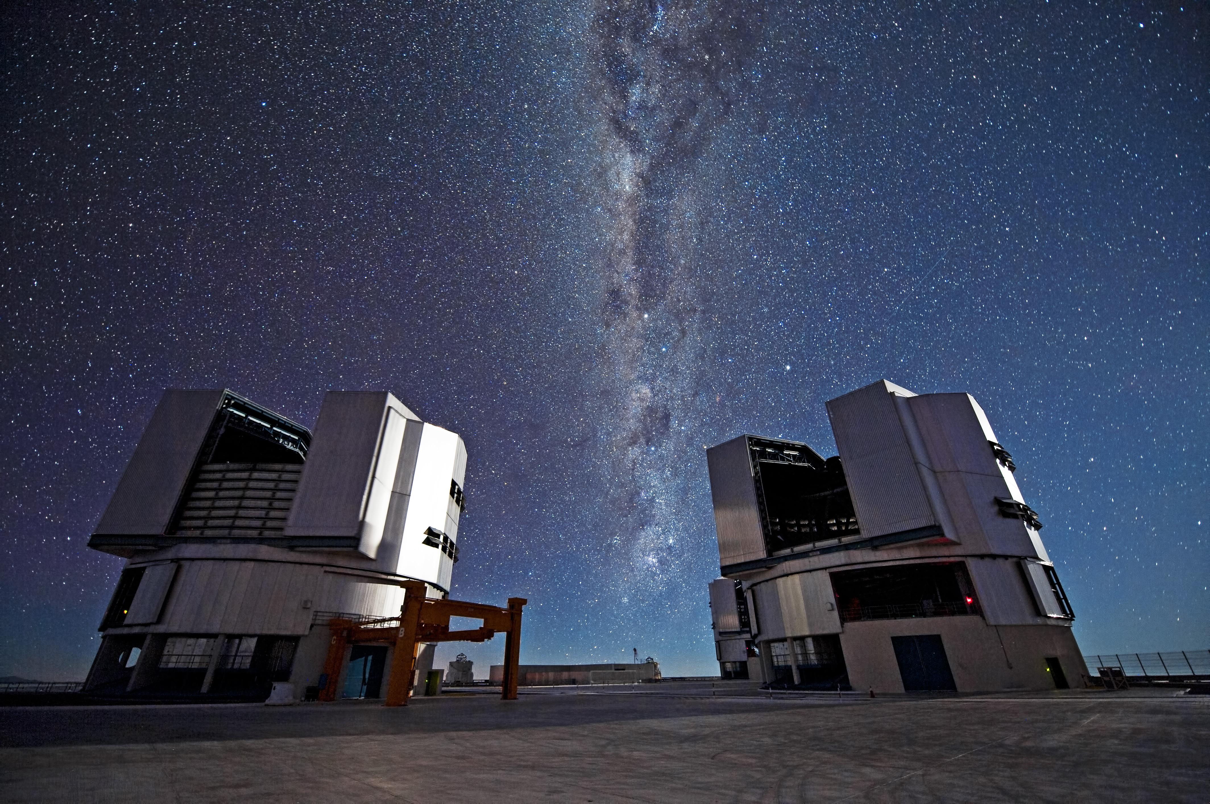
SPACE EXPLORATION UNIT
Topic 2 – Stronger eyes and better numbers
Notes:
On a remote mountaintop, 2600 metres above sea level in the Chilean Atacama Desert, lies the world’s most advanced visible-light observatory. The European Southern Observatory’s Very Large Telescope (VLT) is not only a window on the Universe; it is also a celebration of modern science and technology.
This photograph shows two of the four Unit Telescopes that make up the VLT. With its giant 8.2-metre diameter mirrors, sensitive detectors, and state-of-the art adaptive optics system, the VLT uses cutting-edge technology at every opportunity. Even the telescope enclosures — the domes — are highly advanced, being thermally controlled to reduce air turbulence in the telescope structure.
Every night the VLT studies the sky to make discoveries about the Universe. Visible in this photo, sweeping between the two Unit Telescopes, is the plane of the Milky Way. Containing billions of stars, it is our own corner of the cosmos, but the VLT's vision can peer much deeper than this, our home galaxy, and look out to the extremes of space, all in the name of science and discovery.
Circumference of earth = 40,075 km (x 7.4 = 296,555 km) and distance to moon = 384,400 km (on average)

Slide 2
Unit Overview - Last Class recap – Any questions?
Unit topic | Status
1 – Azimuth-altitude (+ activity) & models of solar system | 75% Complete
2 – Telescopes, elliptical orbits & universal gravitation | Today
3 – The Spectroscope & Doppler effect
4 – Bigger telescopes and triangulation ( + activity)
5 – Radio telescopes
6 – Rockets, computers, hazards of space, microgravity, space stations, gravitational assist, CCD’s and satellites / GPS
7 – The Solar System
8 – People in Space

Slide 3
400 Years of the Telescope
Magnify and increase the resolving power (detail you see)
Invented by Dutch lensmaker Hans Lippershey in 1608
Improved by Galilea Galileo who turned it on the heavens
Galileo saw that Jupiter moons circled Jupiter & not earth, disproving the Geocentric model
Think of them as light collectors (gather & focus light).
Optical telescopes cannot be used in the day.
The greater the area of lenses/mirrors, the more resolving power.

Slide 4
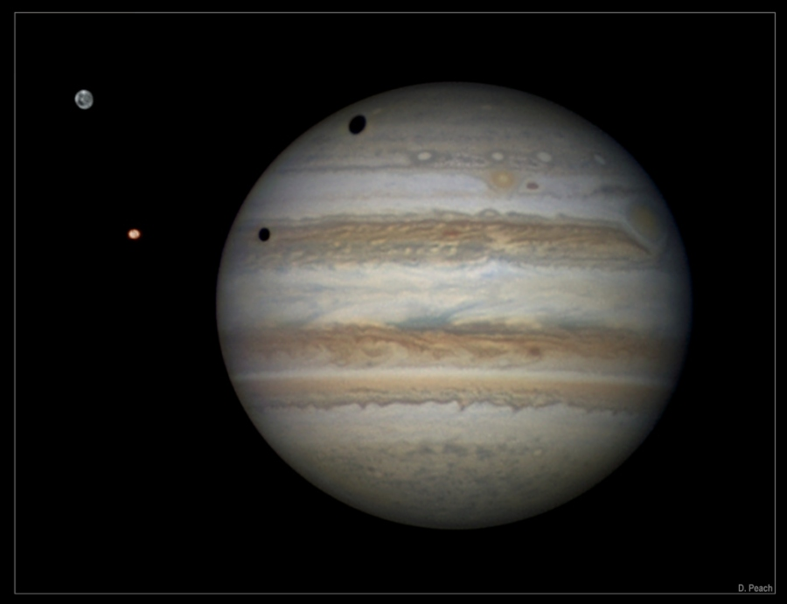
Jupiters Moons – http://apod.nasa.gov/apod/ap130215.html
What did we discuss last class about these moons?

Slide 5
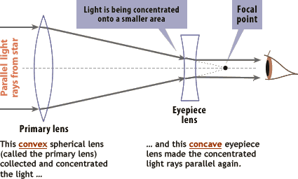
Three (3) kinds of telescope
Refracting telescope (1st kind)
There is a limit to size of primary (objective) lens. Greater than 1m diameter results in distortion

Slide 6
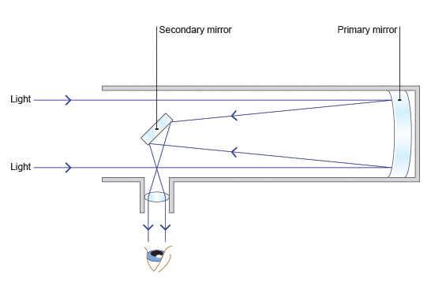
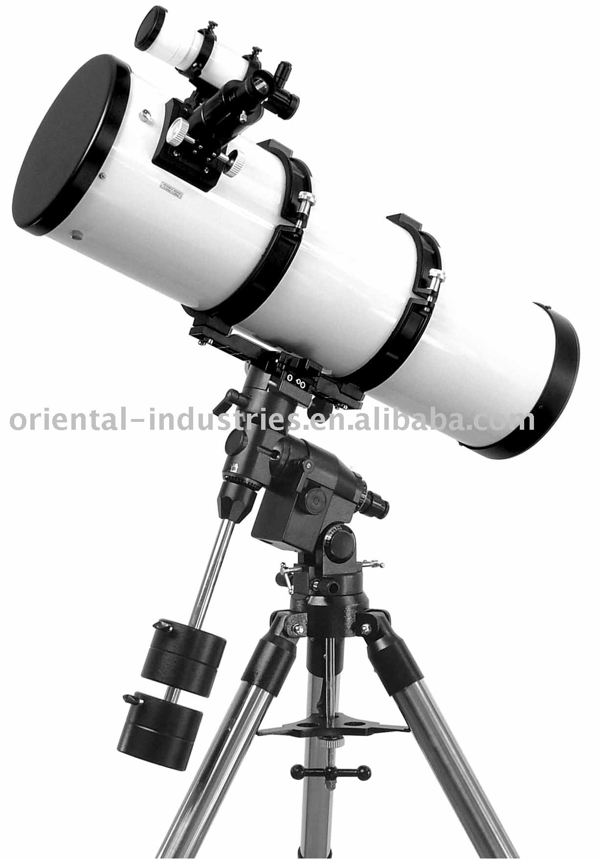
Three (3) kinds of telescope
Reflecting telescope use mirrors over lenses.
Primary (objective) mirror is large concave and is made from glass-like material (eg aluminum) with thin metal coating.
Can be much larger than refracting telescopes so they can see further into space.

Slide 7
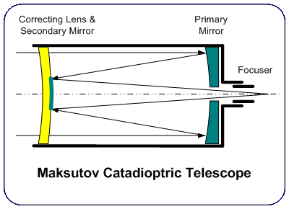
Three (3) kinds of telescope
Combination telescope

Slide 8
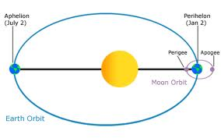
Elliptical orbits
In 1609, Johannes Kepler calculated that planets motions would be more accurate if orbits were elliptical rather than circular.
http://www.youtube.com/watch?v=gvSUPFZp7Yo

Slide 9
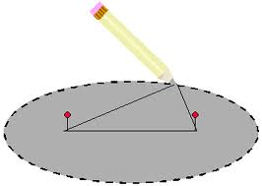
Elliptical orbits
Drawing an ellipse.
http://www.youtube.com/watch?v=7UD8hOs-vaI
What shape is approached as the two foci get closer?

Slide 10
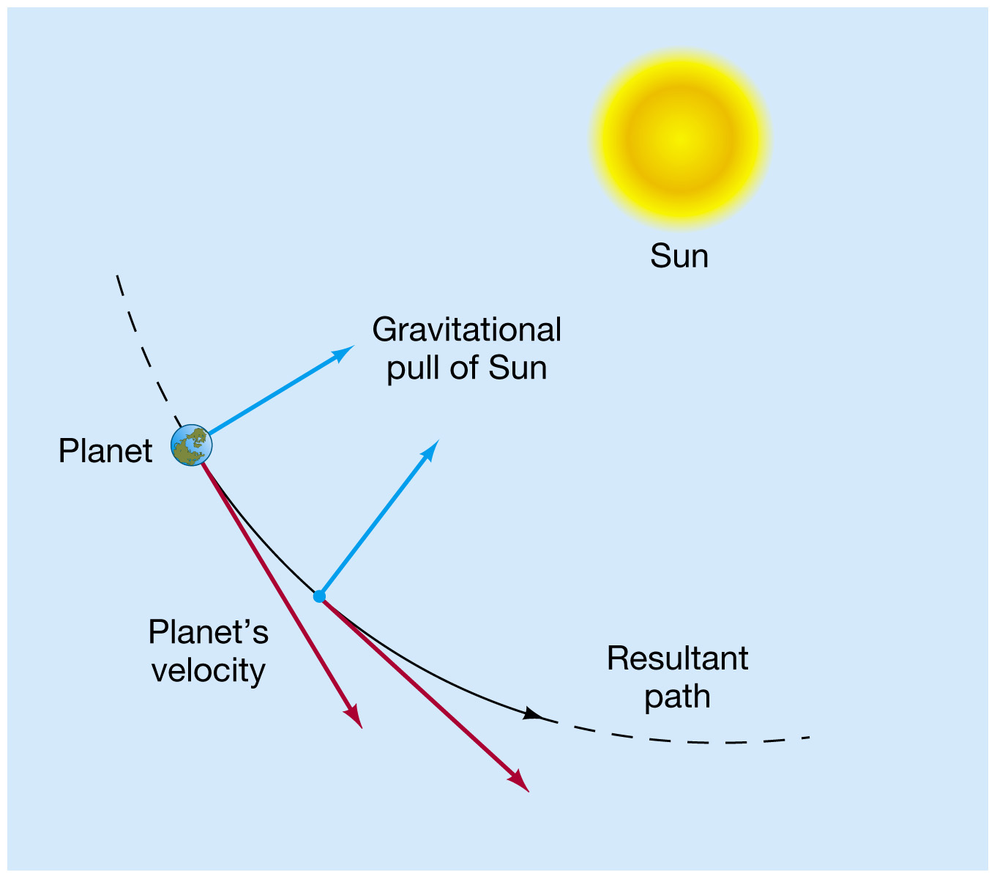
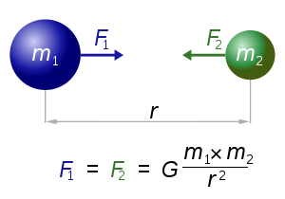
Universal Gravitation
How do planets stay in stable orbits around the sun?

Slide 11
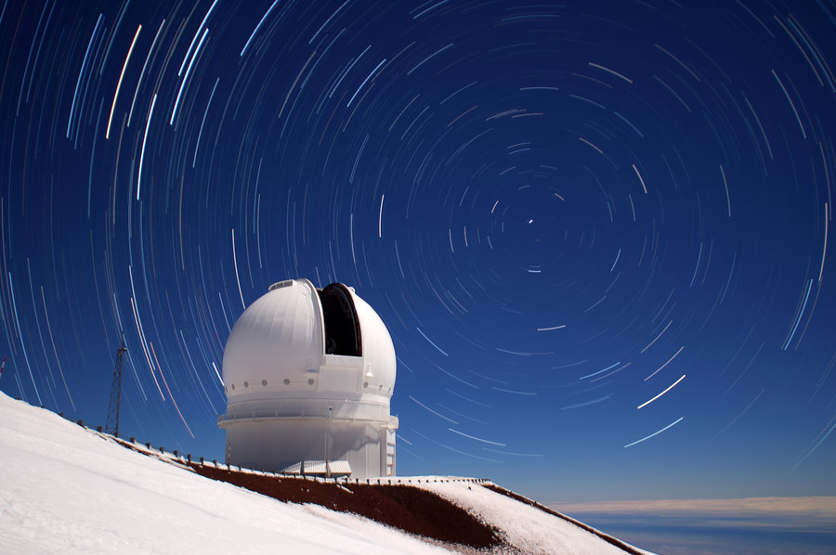
Reflecting telescope on Hawaii
Why might this telescope be located 4204 meters on top of Mauna Kea Mountain on the big island of Hawaii?

Slide 12
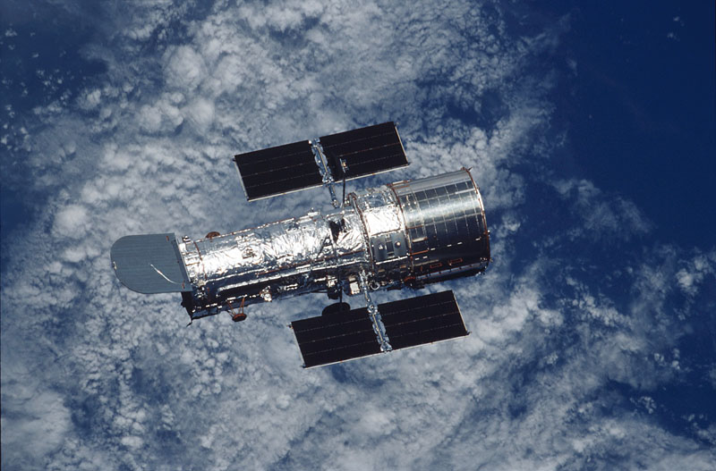
Hubble Reflecting Telescope
What problems might telescopes on earth experience?
What solution to these problems might Hubble offer?
Notes:
Remote mountains are excellent sites for telescopes away from light and air pollution but astronomers are still at the mercy of weather.
Clouds, humidity (moisture in the air) and even high winds can interfere with star-gazing.
The Hubble telescope offers soultion to these problems.
Orbits 600 km above earth.
Reflecting telescope that uses a series of mirrors to focus light.
Launched in 1990.
13 m in length and 4.3 m in diameter at its widest point.
Each orbit around the earth is 95 min (orbit speed is 7.5 km/sec).
Cost $2.5 B.

Slide 13
Recap:
Refracting telescopes have a ________ for the objective.
Reflecting telescopes have a ________ for the objective.
Combination telescopes have a ________ at the front and an objective ________ at the back.

